Slide 1
UNIT – I(B)

Slide 2
Contents
Introduction
- Components
- Data Representation
- Data Flow
Networks
- Network Criteria
- Physical Structures
- Categories of Networks
The Internet
Protocols and Standards
Network Models
- Layered Tasks
- The OSI Model
- Layers in the OSI Model
- TCP/IP Protocol Suite
- Addressing

Slide 3
Network Models
A network is a combination of hardware and software that sends data from one location to another.
Hardware consists of the physical equipment that carries signals from one point of the network to another.
Software consists of instruction sets that make possible the services that we expect from a network.
Computer networks are created by different entities.
Standards are needed so that these heterogeneous networks can communicate with one another.

Slide 4
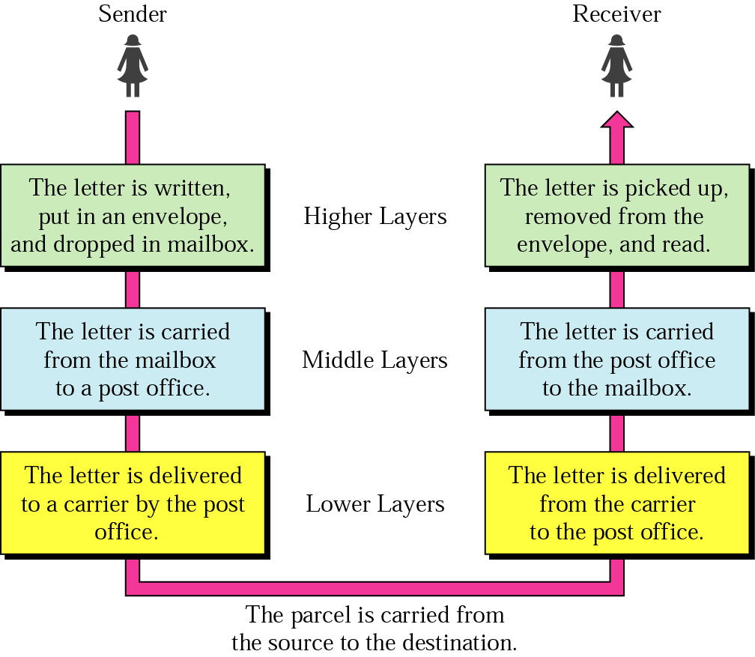
Layered Tasks(1)
Fig.Tasks involved in sending a letter

Slide 5
Layered Tasks(2)
we use the concept of layers in our daily life. As an example, let us consider two friends who communicate through postal mail.
something that is not obvious immediately is that the tasks must be done in the order given in the hierarchy.
each layer at the sending site uses the services of the layer immediately below it. The sender at the higher layer uses the services of the middle layer. The middle layer uses the services of the lower layer. The lower layer uses the services of the carrier.

Slide 6
Layered Tasks(3)
the tasks involved in data exchange are grouped as hierarchical layers.
each layer uses the services of the layer immediately below it.
the two layered models that dominated data communications and networking are Open Systems Interconnection (OSI) model and TCP/IP protocol suite.

Slide 7
The OSI Model(1)
An ISO standard that covers all aspects of network communications is Open Systems Interconnection (OSI) model
First introduced in late 1970s.
It is a set of protocols that allows any two different systems to communicate regardless of their underlying architecture.
It is not a protocol; it is a model for understanding and designing a network architecture that is flexible, robust, and interoperable.
It consists of seven ordered, separate but related layers, each of which defines a part of the process of moving information across a network.

Slide 8

OSI Model
ISO is the organization. OSI is the model.

Slide 9
The OSI Model(3)
Each layer defines a family of functions distinct from those of the other layers.
Within a single machine, each layer calls upon the services of the layer just below it. Between machines, layer x on one machine communicates with layer x on another machine.
This communication is governed by an agreed-upon series of rules and conventions called protocols.
The processes on each machine that communicate at a given layer are called peer-to-peer processes.

Slide 10

Interaction between layers in the OSI model
Shows the layers involved when a message is sent from device A to device B. As the message travels from A to B, it may pass through many intermediate nodes.

Slide 11
The OSI Model(5)
At the physical layer, communication is direct.
Each layer in the sending device adds its own information to the message it receives from the layer just above it and passes the whole package to the layer just below it.
At layer 1 the entire package is converted to a form that can be transmitted to the receiving device.
At the receiving machine, the message is unwrapped layer by layer, with each process receiving and removing the data meant for it.

Slide 12
The OSI Model(6)
the passing of the data and network information down through the layers of the sending device and back up through the layers of the receiving device is made possible by an interface between each pair of adjacent layers.
each interface defines the information and services a layer must provide for the layer above it.
physical, data link and network layers – network support layers; they deal with the physical aspects of moving data from one device to another.
session, presentation and application layers – user support layers; they allow interoperability among unrelated software systems.

Slide 13
The OSI Model(6)
laye r 4, the transport layer, links the two subgroups and ensures that what the lower layers have transmitted is in a form that the upper layers can use.
the upper OSI layers are almost always implemented in software; lower layers are a combination of hardware and software, except for the physical layer, which is mostly hardware.
Fig. in the next slide gives the overall view of the OSI layers, D7 means the data unit at layer 7, D6 means the data unit at layer 6, and so on.
the process starts at layer 7, then moves from layer to layer in descending, sequential order.

Slide 14

At each layer, a header, or possibly a trailer, can be added to the data unit.
When the formatted data unit passes through the physical layer, it is changed into an electromagnetic signal and transported along a physical link.
An exchange using the OSI model

Slide 15
The OSI Model(8)
Upon reaching its destination, the signal passes into layer 1 and is transformed back into digital form. The data units then move back up through the OSI layers.
As each block of data reaches the next higher layer, the headers and trailers attached to it at the corresponding sending layer are removed, and actions appropriate to that layer are taken.
By the time it reaches layer 7, the message is again in a form appropriate to the application and is made available to the recipient.
The data portion of a packet at level N – 1 carries the whole packet from level N. The concept is called encapsulation; level N-1 is not aware of which part of the encapsulated packet is data and which part is the header or trailer. For level N – 1, the whole packet coming from level N is treated as one integral unit.

Slide 16

Layers in the OSI model: Physical Layer
It is responsible for movements of individual bits from one hop (node) to the next.

Slide 17
It is concerned with the following:
Physical characteristics of interfaces and medium
Representation of bits
Data rate
Synchronization of bits
Line configuration
Physical topology
Transmission mode

Slide 18

Layers in the OSI model: Data Link Layer
The data link layer is responsible for moving frames from one hop (node) to the next.
Transform the physical layer to a reliable (error-free) link

Slide 19
Other responsibilities of the data link layer:
Framing
Physical addressing
Flow control
Error control
Access control

Slide 20

Hop-to-Hop Delivery
2-<number>

Slide 21

Layers in the OSI model: Network Layer
The network layer is responsible for the delivery of packets from the source host to the destination host
Logical addressing and routing

Slide 22

2-<number>

Slide 23

Layers in the OSI model: Transport Layer
The transport layer is responsible for delivery of a message from one process to another

Slide 24
Other responsibilities
Service-point (port) addressing
Segmentation and reassembly
Connection control
Flow control
Error control

Slide 25

Reliable Process-to-Process Delivery of a Message

Slide 26

Layers in the OSI model: Session Layer
Session layer is responsible for dialog control and synchronization

Slide 27

Layers in the OSI model: Presentation Layer
Presentation layer is responsible for translation, compression, and encryption

Slide 28

Layers in the OSI model: Application Layer
Application layer is responsible for providing services to the user

Slide 29
It enables the user, whether human or software, to access the network.
It provides user interfaces and support for services such as electronic mail, remote file access and transfer, shared database management, and other types of distributed information services.
Of the many application services available, the figure shows only three:
- message-handling services (X.400)
- File transfer, access, and management
- Directory services (X.500)

Slide 30

Summary of Layers

Slide 31

TCP/IP and OSI Model

Slide 32
TCP/IP Protocol Suite
Host-to-network : Physical and data link layer
  No specific protocol
  Supports all standard and proprietary protocols
Network layer: supports
  IP(Internetworking Protocol)
  IP, in turn, uses 4 supporting protocols: ARP(Address Resolution Protocol), RARP(Reverse ARP), ICMP(Internet Control Message Protocol), IGMP(Internet Group Message Protocol)
Transport layer
  TCP(Transmission Control Protocol), UDP(User Datagram Protocol), SCTP(Stream Control Transmission Protocol),
Application Layer
  Combined session, presentation, and application layers in the OSI model.

Slide 33
IP
  An unreliable and connectionless protocol
  a best-effort delivery service: means IP provides no error checking or tracking, does its best to get a transmission through to its destination, but with no guarantees.
  Transports data in packets called datagrams
  Datagrams can travel along different routes and can arrive out of sequence or be duplicated.
  No facility for reordering datagrams at the destination
ARP
  To find physical address of the node when its Internet address is known
RARP
  Allows a host to discover its Internet address when it knows only its physical address.
ICMP
  Used by hosts ad gateways to send notification of datagram problems back to the sender. It sends query and error reporting messages.
IGMP
  Used to facilitate simultaneous transmission of a message to a group of recipients.

Slide 34
UDP
  is simpler
  It adds only port addresses, checksum error control, and length information to the data from the upper layer
TCP
  is a reliable protocol: provides acknowledgement
  it is connection oriented: a connection must be established between both ends of a transmission before either can transmit data
  Divides a stream of data into smaller units called segments. Each segment includes a sequence number for reordering after receipt
SCTP
  Combines the best features of UDP and TCP.
  Provides support for applications such as voice over the Internet.

Slide 35

Addressing
Four levels of addresses in TCP/IP protocols
Physical (link), logical (IP, network), port, and specific addresses

Slide 36

Relationship of Layers and Addresses in TCP/IP

Slide 37
Physical Address
  is the address of a node as defined by its LAN or WAN.
  It is lowest-level address
  It is included in the frame used by the data link layer.
  Size and format of these addresses vary depending on the network.
  For example, Ethernet uses a 6-byte physical address
Logical Addresses
  These are necessary for universal communications that are independent of underlying physical networks.
  A logical address in the Internet is currently a 32-bit address
Port Address
  In the TCP/IP architecture, the label assigned to a process is called a port address.
  A port address in TCP/IP is 16 bits in length.

Slide 38

Physical Address
A node with physical address 10 sends a frame to a node with physical address 87. The two nodes are connected by a link (bus topology LAN). As the figure shows, the computer with physical address 10 is the sender, and the computer with physical address 87 is the receiver.
07:01:02:01:2C:4B
A 6-byte (12 hexadecimal digits) physical address.

Slide 39

Logical (IP) Address
The physical addresses will change from hop to hop, but the logical addresses usually remain the same

Slide 40

Port Address
The physical addresses change from hop to hop, but the logical and port addresses usually remain the same.

Slide 41
Specific Address
Some application have user-friendly addresses that are designed for that specific address
Example 1: e-mail address: kchung@kw.ac.kr
  Defines the recipient of an e-mail
Example 2: URL (Universal Resource Locator) : www.kbs.com
  Used to find a document on the WWW
These addresses, however, get changed to the corresponding port and logical addresses by the sending computer

